Slide 1



SOSC 4300 Literature Review
How social media captures the evolvement of social movement
Group: idk-lol
Lam Hoi San 20506775 Tin man sing 20521256
LEUNG MAN CHOI 20521189 Au-Yeung Tsz Wai 20520460

Slide 2
Introduction
Social Media and Social Movement
4 main uses of social media (Lynch, 2011; Hussain & Howard, 2011):
  1) Organizing and coordinating events
  2) Creating an information flow among participant and the public
  3) Connect and mobilize protestors
  4) Share grievances and online community against regime

Slide 3
Introduction
Traditional Method: Survey and Interview
Shen, Xia & Skoric (2020): survey of university students during occupy central
  How social media affects social movement participation and political attitude
  Quota sampling [n = 769]
Chu(2018): interview secondary school students
  How social media impact the participatory level of occupy central movement
  Interview conducted after the movement ends (early 2015) [n = 14]

Slide 4

Background
Limitations in the traditional method:
  1) Limited sample size low representativeness
  2) Interaction among participants, activists and public remain unclear
  3) Focus on the post social movement attitude
  4) Fails to capture the trend during social movement

Slide 5
Importance
The Big-data/computational approach offers...
  Sentiment and content analysis of the posts in social media
  Follow the trends of hashtag/ topics
  Social Network Analysis to study the information flow

Slide 6
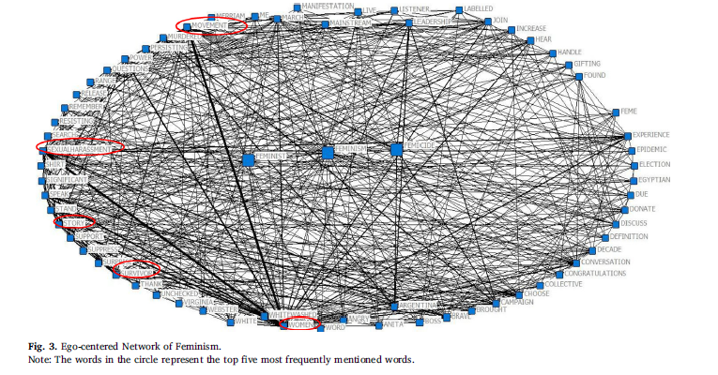
Literature 1: hashtag activism and message frames among social movement organizations: semantic network analysis and thematic analysis of twitter during the #metoo movement (Xiong, Cho & Boatwright, 2019)
Study the Tweets in the #Metoo movement
Normalized degree centrality to study the prominence of words
Number of # is not correlated with the "retweetability" of a post

Slide 7
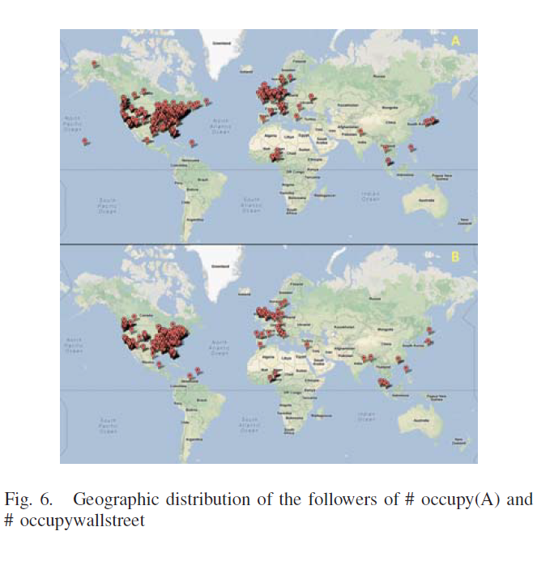
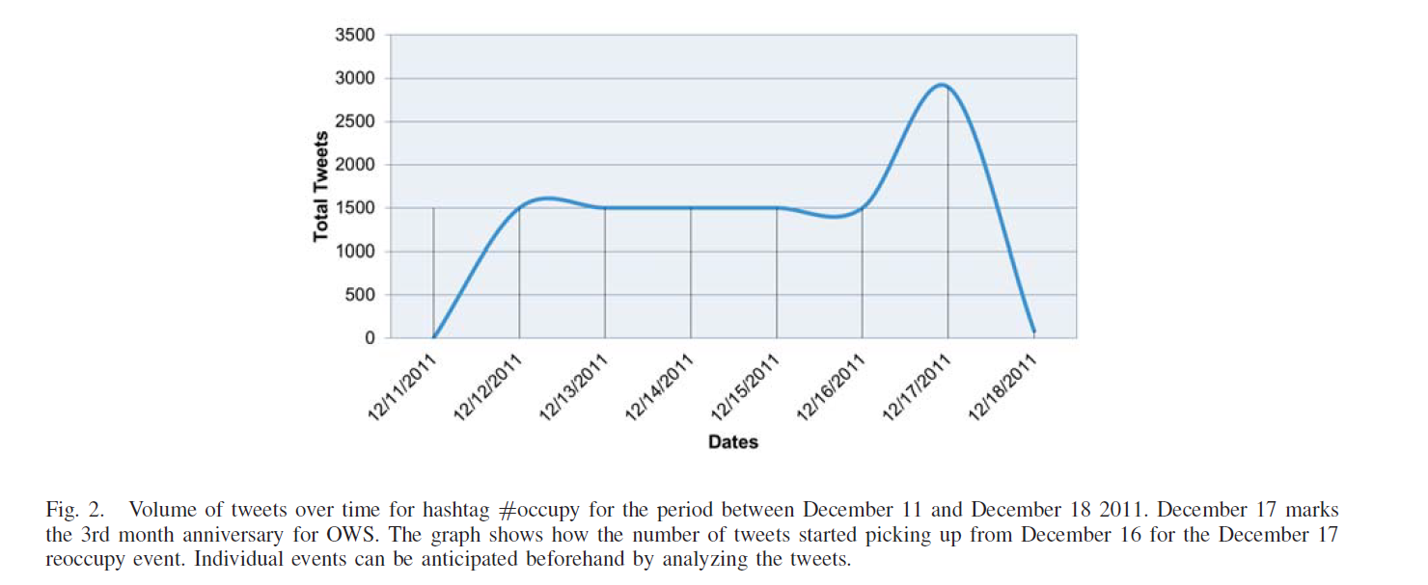
Literature 2: analyzing the impact of social media on social
movements: a computational study on twitter and the occupy wall street movement (Li, Ponnam, Gillham, Edwards & Johnson, 2013).
Offered different directions in utilizing social media
Use the trend to predict an event
Associations of geographic distribution of accounts and the actual events
Textual and sentiment analysis to study the emotions conveyed in the posts

Slide 8
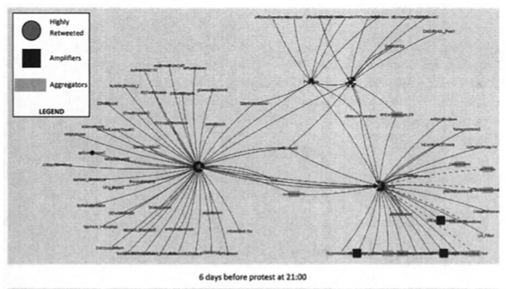
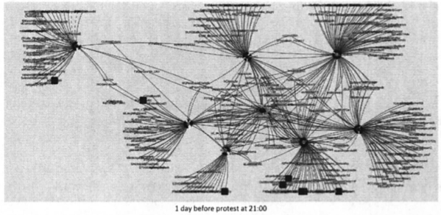
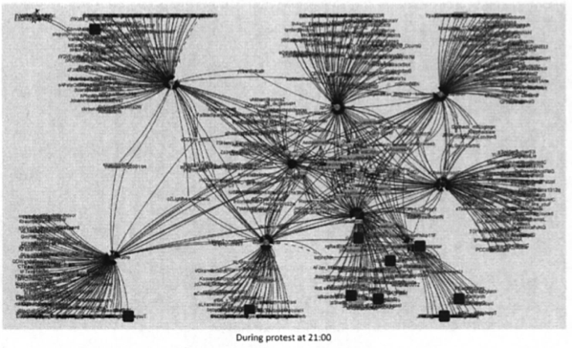
Literature 3: Big Data: Methodological Challenges and Approaches for Sociological Analysis
- Analyze the Twitter data related to the protest on UK University fees
- Dynamic visualisation of the social network over time
Tinata, R., Halford S., Carr L., Pope C. (2014)

Slide 9
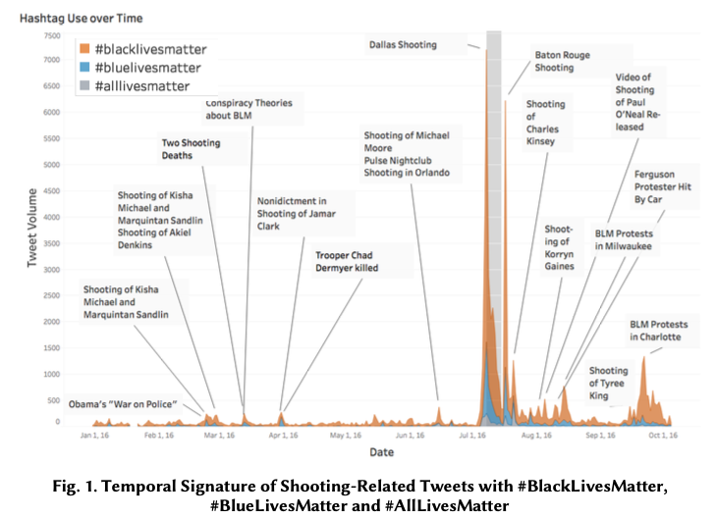
Literature 4: Drawing the Lines of Contention: Networked Frame Contests Within #BlackLivesMatter Discourse
Leo G. Stewart, Ahmer Arif, A. Conrad Nied, Emma S. Spiro, and Kate Starbird. (2017)
- Using Twitter Streaming API and capture 58,812,322 Twitter posts
- 1st: search the posts that contain the incident related keywords such as “shooting”, “gun-shot” etc.
- 2nd: subset the tweets that contains keywords related to Black Lives Matter

Slide 10

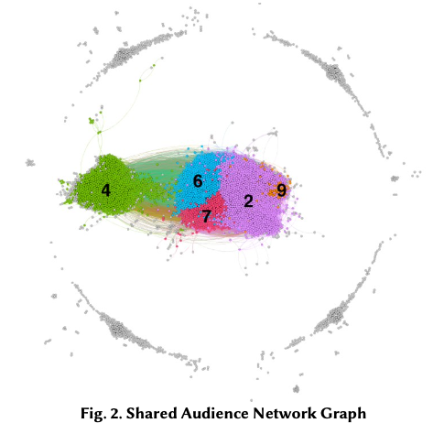
Literature 4: Drawing the Lines of Contention: Networked Frame Contests Within #BlackLivesMatter Discourse
Leo G. Stewart, Ahmer Arif, A. Conrad Nied, Emma S. Spiro, and Kate Starbird. (2017)
"Share Audience" Measure
- Using Jaccard similarity to calculate the friend-following ties and retweet-mention ties.
- Cluster the data by Louvain modularity
- Qualitative alalysis on the cluster's content
- Analyze the Top 25 most retweeted tweet of each cluster
- understanding how the issue is farmed

Slide 11
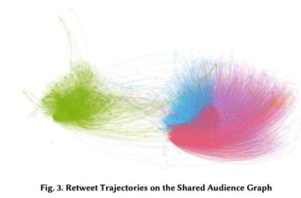
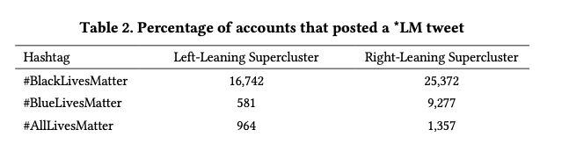
Literature 4: Drawing the Lines of Contention: Networked Frame Contests Within #BlackLivesMatter Discourse
Leo G. Stewart, Ahmer Arif, A. Conrad Nied, Emma S. Spiro, and Kate Starbird. (2017)
- Actors' interactions
Both side of the cluster would also like to use hashtag of the opposite side to challenge the frame of the opposite parties

Slide 12
Advantages and challenges
Advantages:
- able to capture the real social activity within a huge population
- easy access of data and analyzing tools (API)
- have a more accurate understanding on the flow of information, and the relations and impact between actors (eg individual users/ media users) overtime
Challenges:
- ethical concerns (privacy)
- small-scale content analysis is still important for a deeper understanding collective frame of the cluster

Slide 13
PROJECT PROPOSAL
Twitter
15 raw data csv files
15000 tweets per files
03/11/2019 to 20/11/2019

Slide 14
PROJECT PROPOSAL
Graphed a temporal distribution
Show the terms appear frequency
Conduct the keywords search twice
Relate each of the spikes

Slide 15
Sentiment classification
Sentiment classification
  NLTK Vader_Lexicon Library
  Compound Score
3 cluster
Word embedding
  Continuous Bag-of-Words model (CBOW)
Measure the Twitter user’s sentiment

Slide 16
PROJECT PROPOSAL
Network analysis
Use twitter REST API to get user data, mainly their list of followers
Random sample of 1000 within the 50000 users in our list
Their most recent 100,000 followers

Slide 17
PROJECT PROPOSAL
Shared audience measure metric between 2 users
The more common followers they have, closer the two users are

Slide 18
PROJECT PROPOSAL
Whether there are distinct clusters
Common attributes within clusters (common hashtags, wordings, locations)
Study the interactions between clusters (numbers of retweets)
Information flow, which are the dominant clusters

Slide 19
PROJECT PROPOSAL
Dynamic of clusters
Whose tweets get retweeted the most
Changes over the 17 days data collection period

